Slide 1
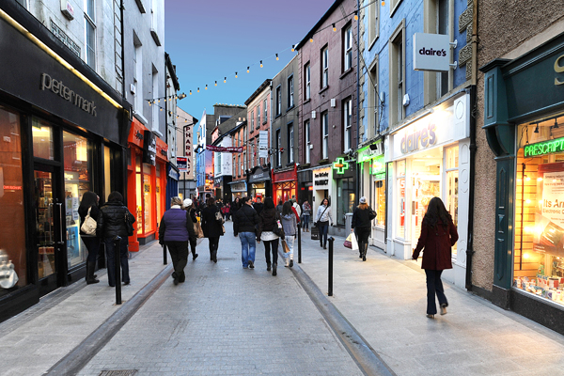


Wexford
Magnet – Regional Business Report
February 2015
Notes:
It’s often said that small and medium enterprises are the lifeblood of any economy, yet they tend to operate in the shadow of larger companies. In fact, with foreign direct investment such a key driver of the Irish economy, the SME voice here is probably less audible than in other countries. Of course, SMEs are not just important because of the volume of jobs they account for. It’s the nature of that employment – that it’s spread across the country, that it’s community-based and that it’s indigenous.
In fact, you may have seen an article in the Irish Times this week where economist John Fitzgerald expressed the view that the role of SMEs is underplayed in our economy. He pointed put that less than one quarter of jobs created last year came from multinationals.
This inaugural Magnet Regional Business Barometer, in recognition of this, aims to give policymakers and others an insight into what the 180,000 firms that make up our SME community are thinking, and how they can be supported better, on a regional basis.
SMEs are resilient. We see that in these findings. Despite the obstacles they face with high operating costs, cash-strapped consumers and banks unwilling to lend, a clear majority are upbeat about what the year ahead has in store for them. That is good news for everyone working and living in this country. Yet not all regions and all SMEs are emitting this positive vibe in equal measure.
Let me take you through the findings …

Slide 2
Magnet Who?
10 Year Old Telecoms & Service Start-up!
Part of Larger International PE Backed Telecoms Organisation.
€120M invested in Ireland in building own Network.
Operations in Ireland and UK
Approx. 4000 Business customers…From Amazon to Zoo
  85% in the SME sector
Prime focus and engagement is with the SME sector.
…..And access to Network in Wexford…outside the Door…..from here to New York in 1 hop!!

Slide 3


A. Methodology
A telephone survey : 600 Irish SMEs with between 1-50 employees.
  Robust samples of the 8 regional authorities in Ireland, sample of 75 in each.
Research was concluded in December 2014.

Slide 4
C. Profile of Sample
(Base: All Irish SME decision makers – 600)
Services
Retail
Manufacturing
Tech/IT
Other
Hospitality
Transport
Construction
Distribution
Fin Services
Notes:
Surveys were conducted among senior business decision makers, e.g. owners, managers etc. Minimum samples of 100 were achieved with business with 1-5, 6-10, 11-20, and 21-50 employees
This chart shows the spread of companies across the various sectors

Slide 5



Section 1: Outlook & Challenges

Slide 6

Business Outlook for Next 12 Months – I
(Base: All Irish SME decision makers – 600)
All SMEs
All SMEs
1-5 emp.
6-10 emp.
11-20 emp.
21-50 emp.
(n=400)
(n=300)
(n=100)
(n=100)
(n=100)
%
%
%
%
%
Very positive
61%
Fairly positive
Neither/Nor
Fairly negative
13%
Very negative
–
Don’t know
–
–
6-in-10 (61%) have a positive business outlook for the next 12 months, lowest among SOHO’s with just 1-5 employees (55%). 1-in-12 (13%) have a negative outlook.
Notes:
What is especially interesting here is that SMEs in Ireland have a far more positive outlook than individuals
Each month since April 2009, Amarach research have tracked attitudes to the economic recovery (using our Economic Recovery Indicator). The score this month was 38.9 (an all-time high). When they ran the same question among SME’s, the score was 45.5. To put this in perspective 75% of SMEs said the economy is improving, while just 55% of the general public felt this was the case

Slide 7
Business Outlook for Next 12 Months – II
(Base: All Irish SME decision makers – 600)
Very negative (5)
Very positive
(1)
(4)
(2)
North (n=75)
West (n=75)
Mid-West (n=75)
South West (n=75)
South East (n=75)
Midland (n=75)
Mid-East (n=75)
Dublin (n=75)
Business Outlook is most positive in the Mid-West and Dublin while the highest negative outlook can be found in the North/Border region – (Donegal, Sligo, Leitrim, Cavan, Monaghan).
Notes:
Firms in manufacturing and non-financial services were the most upbeat about the future. SMES in construction, hospitality and retail were least optimistic.

Slide 8
Likelihood That Business Will Open New Premises in Next 12 Months
(Base: All Irish SME decision makers – 600)
Very unlikely (5)
Very likely
(1)
(4)
(2)
North (n=75)
West (n=75)
Mid-West (n=75)
South West (n=75)
South East (n=75)
Midland (n=75)
Mid-East (n=75)
Dublin (n=75)
Likelihood to open a new premises is highest in regions such as the Mid-East – 16% (Meath, Kildare, Wicklow). No Midland SME decision makers said this was likely in 2015.
Notes:
Nearly 1-in-10 (9%) SMEs say they are likely to open a new premises within the next 12 months. This rises to 16% among those with 6-10 employees.

Slide 9
Likelihood that Business will Invest in IT Infrastructure
(Base: All Irish SME decision makers – 600)
Very unlikely
(5)
Very
likely
(1)
(4)
(2)
North (n=75)
West (n=75)
Mid-West (n=75)
South West (n=75)
South East (n=75)
Midland (n=75)
Mid-East (n=75)
Dublin (n=75)
SMEs in Dublin (52%), the Mid-East – 46% (Meath, Kildare, Wicklow) and South-West – 40% (Cork, Kerry) are more likely to invest in IT infrastructure than others.
Notes:
3-in-10 SMEs plan on investing in IT infrastructure within the next 12 months, driven primarily by those with 21-50 employees where over half (56%) plan to do so.

Slide 10
Challenges When Recruiting Staff
(Base: All Irish SME decision makers – 600)
All SMEs
North (n=75) | West (n=75) | Mid-West (n=75) | South West (n=75) | South East (n=75) | Midland (n=75) | Mid-East (n=75) | Dublin (n=75)
22% | 35% | 31% | 40% | 30% | 30% | 47% | 58%
10% | 4% | 12% | 14% | 13% | 6% | 11% | 10%
7% | 11% | 14% | 13% | 13% | 11% | 7% | 11%
7% | 3% | 5% | 3% | 0% | 1% | 3% | 6%
4% | 0% | 1% | 3% | 4% | 1% | 0% | 0%
1% | 3% | 5% | 1% | 1% | 3% | 0% | 0%
0% | 4% | 1% | 1% | 0% | 3% | 3% | 2%
0% | 2% | 0% | 1% | 2% | 0% | 5% | 0%
52% | 45% | 41% | 27% | 44% | 41% | 24% | 23%
1% | 4% | 2% | 6% | 3% | 1% | 5% | 5%
(n=400)
%
Finding candidates with right skills
Cutbacks in budget
Finding graduates with right skills
Competition from other employers
Social welfare benefits
Tax is too high
Brain drain
High salary expectations
Not applicable
Other
The issue of finding the right skills is most pervasive in Dublin

Slide 11

Section 2: Government
Attitudes & Grants

Slide 12
Feel the Government is Doing Enough for SME’s
(Base: All Irish SME decision makers – 600)
No, doing very little
(5)
Yes, doing
a lot
(1)
(4)
(2)
North (n=75)
West (n=75)
Mid-West (n=75)
South West (n=75)
South East (n=75)
Midland (n=75)
Mid-East (n=75)
Dublin (n=75)
Only 9% of SME decision makers in the Capital feel the Government enough to support them

Slide 13
Know Local Government Rep./Councillor
(Base: All Irish SME decision makers – 600)
No
%
North (n=75)
West (n=75)
Mid-West (n=75)
South West (n=75)
South East (n=75)
Midland (n=75)
Mid-East (n=75)
Dublin (n=75)
3-in-10 (29%) SME decision makers do not know who their local Government representative/ councillor is. This is highest among those in companies with 21-50 employees (45%), and in Dublin where 70% don’t know who this person is.

Slide 14
Feel Local Government Rep./Councillor is Doing Enough for SME’s
(Base: All Irish SME decision makers – 600)
No, doing very little
(5)
Yes, doing
a lot
(1)
(4)
(2)
North (n=75)
West (n=75)
Mid-West (n=75)
South West (n=75)
South East (n=75)
Midland (n=75)
Mid-East (n=75)
Dublin (n=75)
Just 2% of Dublin SME decision makers feel their local government representative/ councillor is doing enough, well behind those in the Mid-East – 29% (Meath , Kildare, Wicklow) and other regions.

Slide 15
Attitudes Towards Budget 2015 for SMEs
(Base: All Irish SME decision makers – 600)
Very negative
(5)
Very positive
(1)
(4)
(2)
North (n=75)
West (n=75)
Mid-West (n=75)
South West (n=75)
South East (n=75)
Midland (n=75)
Mid-East (n=75)
Dublin (n=75)
Attitudes towards Budget 2015 are relatively similar across the country, with those in Dublin being most positive (61%).

Slide 16
Aware of Government Business/Technology Grants for SMEs
(Base: All Irish SME decision makers – 600)
Not aware of…
%
North (n=75)
West (n=75)
Mid-West (n=75)
South West (n=75)
South East (n=75)
Midland (n=75)
Mid-East (n=75)
Dublin (n=75)
Lowest!
Just 1-in-10 (11%)SMEs are aware of Government business/technology grants that are available to them. Lack of awareness is highest amongst small businesses
Notes:
Awareness is highest for SMEs in the Manufacturing sector (30%) and the Technology sector (39% ).

Slide 17
Access to Government Business/Technology Grants – I (Enterprise Ireland Voucher)
(Base: All Irish SME decision makers – 600)
Don’t know/NA 4%
All SMEs
(n=400)
Tried unsuccessfully 5%
%
Accessed successfully 3%
In process 2%
Never tried 87%
Just 3% of SMEs have successfully accessed the Enterprise Ireland Voucher (€5,000) while 5% have tried but were unsuccessful. Larger SMEs have been much more successful in this regard.

Slide 18
Access to Government Business/Technology Grants – II (Online Trading Voucher)
(Base: All Irish SME up to 10 staff)
(n=400)
Tried unsuccessfully 1%
In process 1%
%
Accessed successfully 3%
NA 6%
Never tried 92%
Just 3% of SMEs have accessed the Online Trading Voucher (€2,500).

Slide 19

Section 3: Staff & Technology

Slide 20
Percentage of Staff who Work from Home on a Regular Basis
(Base: All Irish SME decision makers – 600)
Average
North (n=75)
West (n=75)
Mid-West (n=75)
South West (n=75)
South East (n=75)
Midland (n=75)
Mid-East (n=75)
Dublin (n=75)
20
24
18
18
16
11
8
12
SMEs in the West have the highest average for employees working from home.

Slide 21
Percentage of Staff who Work on the Road on a Regular Basis
(Base: All Irish SME decision makers – 600)
Average
North (n=75)
West (n=75)
Mid-West (n=75)
South West (n=75)
South East (n=75)
Midland (n=75)
Mid-East (n=75)
Dublin (n=75)
21
22
26
18
10
13
18
21
SMEs in the Mid-West (Clare, Limerick, North Tipp.) have the highest average for employees working on the road (26% - when the 0 score is removed). This is lowest in the South-East – 10% (South Tipp., Waterford, Kilkenny, Carlow, Wexford).
Notes:
67% of SMEs say none of their staff work on the road with a sixth (16%) saying between 80-100% of their staff do so. This is highest among SOHOs at 18%.

Slide 22
Staff Access to Smartphones for Business
(Base: All Irish SME decision makers – 600)
Company Supplied
%
North (n=75)
West (n=75)
Mid-West (n=75)
South West (n=75)
South East (n=75)
Midland (n=75)
Mid-East (n=75)
Dublin (n=75)
SMEs in Dublin provide 43% of their staff with smartphones on average, well above others such as in the North/Border region – 14% (Donegal, Sligo, Leitrim, Cavan, Louth, Monaghan).
Notes:
Excluding those for whom it is not applicable, on average a quarter of staff in SMEs are provided with a company smartphone. This drops to 11% for tablets and back up to 20% for company supplied laptops.
SMEs with 6-10 employees provide the most staff (on average) with a smartphone (35%). This drops back down to 23% among larger SMEs who may place greater concern on BYOD challenges and data protection.

Slide 23
Access to Company Services over Smartphones
(Base: All Irish SME decision makers – 600)
%
Company email
Company documents
CRM
Hosted/cloud phone system
None of these
For those who have personal/company supplied smartphones/tablets/laptops, the majority can access company email (86%+) while smaller proportions can access company documents (32%+), CRM (27%+) or hosted/cloud phone systems (23%+) off-site.

Slide 24
Phone System Used in Business
(Base: All Irish SME decision makers – 600)
North (n=75) | West (n=75) | Mid-West (n=75) | South West (n=75) | South East (n=75) | Midland (n=75) | Mid-East (n=75) | Dublin (n=75)
91% | 80% | 88% | 79% | 90% | 92% | 86% | 65%
69% | 70% | 83% | 69% | 72% | 78% | 76% | 87%
7% | 15% | 9% | 14% | 6% | 11% | 17% | 29%
2% | 1% | 8% | 8% | - | 3% | 6% | 26%
- | - | 1% | 2% | 3% | 2% | 6% | 14%
- | - | - | - | - | - | - | 3%
Standard telephone line
Mobile phones
On premise phone system
VOIP phone – Skype etc.
Hosted on cloud phone
Don’t know
Those in Dublin are most likely to have an on-premise phone system (29%) while this is considerably less popular in other regions. Similarly 26% of Dublin SMEs say they use VOIP which is much lower elsewhere.
Notes:
Nearly 9-in-10 SMEs say they have a standard company landline. This decreases for larger SMEs (21-50 employees) who are more likely than others to say they use an on-premise system (30%).

Slide 25

Section 4: Cloud Services

Slide 26
Cloud Service in place
(Base: All Irish SME decision makers – 600)
North (n=75) | West (n=75) | Mid-West (n=75) | South West (n=75) | South East (n=75) | Midland (n=75) | Mid-East (n=75) | Dublin (n=75)
14% | 23% | 30% | 26% | 18% | 15% | 21% | 45%
SME businesses in Dublin (45%) and the Mid-West – 30% (Clare, Limerick, North Tipp.) are more likely than other to have a staff cloud system in place. 85% in the North/Border region (Donegal, Sligo, Leitrim, Cavan, Louth, Monaghan) do not use the cloud.
Notes:
When asked if they have implemented any cloud solution in their business, only 20% of SMEs say they have. This highlights a lack of understanding of what the cloud is and how it works. It is clear from the above that many organisations have some operations in the cloud but are not aware that they are cloud based.
Implementation of cloud services is highest among SMEs with 21-50 employees (45%) and, perhaps not surprisingly, among those in the tech sector (80% - base size of 28).

Slide 27
Cloud Solutions Implemented
(Base: All who have implemented cloud – 155)
%
Email
Collaboration Sharing documents e.g. project tools/Google docs
Existing business applications
Customer relations management (CRM)
New business applications
Don’t know
Among those who have implemented a cloud solution, two thirds (68%) say this is email related, half (51%) utilise collaboration tools while 40% access existing business applications.

Slide 28
Benefits Experienced by Moving to the Cloud
(Base: All who have implemented cloud – 155)
%
Remote access to system – mobility
Allows staff work from home – mobility
Reduced costs – savings
Increased productivity
Knowledge that there is a back up online
Increased efficiency
Better storage
The primary benefits of the cloud relate to mobility, i.e. remote access (41%) and allowing staff to work from home (13%). 1-in-8 (11%) also said it results in reduced costs and greater productivity.

Slide 29
Main Reasons for not Moving to the Cloud
(Base: All who have not implemented cloud – 439)
North (n=64) | West (n=58) | Mid-West (n=56) | South West (n=54) | South East (n=62) | Midland (n=63) | Mid-East (n=54) | Dublin (n=34)
60% | 65% | 64% | 53% | 63% | 65% | 62% | 32%
9% | 10% | 12% | 15% | 8% | 10% | 16% | 4%
6% | 8% | 8% | 6% | 7% | 10% | 7% | -
6% | 11% | 12% | 10% | 4% | 4% | 2% | -
1% | 2% | - | 5% | 6% | 10% | 4% | 17%
9% | 3% | 2% | 6% | 3% | - | 4% | 11%
9% | 8% | 8% | 8% | 8% | 4% | 8% | 14%
Doesn't suit our company
Haven't got time to research
Prefer to keep functions in house
Available broadband insufficient
Concerned about security
Cost
Don’t know
Notes:
Among those who have not implemented cloud solutions, two-thirds (64%) say it is because it does not suit their company. This is the main response provided across business size, although larger SMEs (11+ employees) are most likely to be concerned about security and cost.

Slide 30
Section 5: Hosted Voice/VOIP

Slide 31
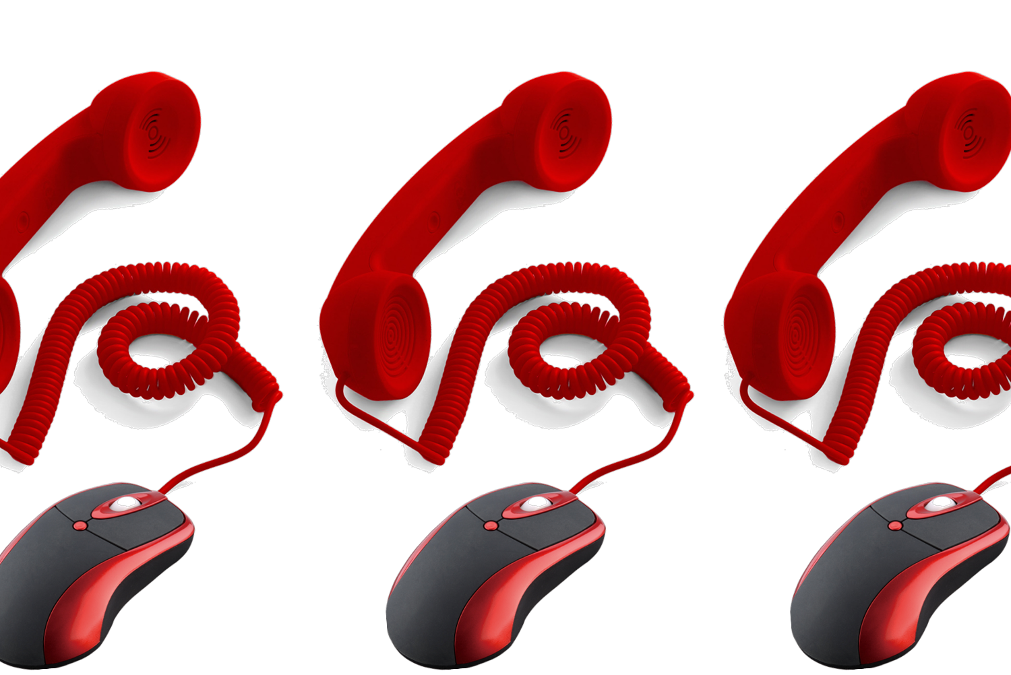
Heard of Hosted Voice/VOIP & Implementation
(Base: All Irish SME decision makers – 600)
All SMEs
1-5 emp.
6-10 emp.
11-20 emp.
21-50 emp.
(n=400)
(n=300)
(n=100)
(n=100)
(n=100)
Heard of:
%
%
%
%
%
Implemented
(10)
(7)
(11)
Considered & likely
to implement
(10)
(17)
(20)
(12)
(9)
(10)
Considered & unlikely to implement
(14)
(24)
(14)
(22)
(14)
(14)
Not implemented /considered
(73)
(64)
(59)
(46)
(49)
() As a % of those who have heard of Hosted Voice/VOIP
4-in-10 (42%) have heard of Hosted Voice/VOIP previously. This increases to 73% among those with 21-50 employees. 4% in total have implemented these while another 5% have considered and are likely to do so.
Notes:
Awareness is higher for sectors such as manufacturing (66%) and technology (83%).
At an overall level 1-in-25 SMEs (4%) have implemented Hosted Voice or VOIP solutions with this number likely to at least double next year, as another 5% have considered it and are likely to implement. We can see significant movement by those with 21-50 employees as 15% have already implemented it while another 16% are likely to do so.

Slide 32
Benefits of Hosted Voice/VOIP
(Base: All who have considered/implemented hosted Voice/VOIP – 80)
%
Reduced cost (general)
Better productivity outside the office
Better access to communication (via computer, laptop, smartphone)
Better productivity inside the office
Reduced cost for transferring calls
Back up services
Easy to manage
The primary benefit of Hosted Voice/VOIP for those have implemented/ are likely to implement is reduced costs (56%) while greater productivity (in and outside of the office) and access to communication are also noted.

Slide 33
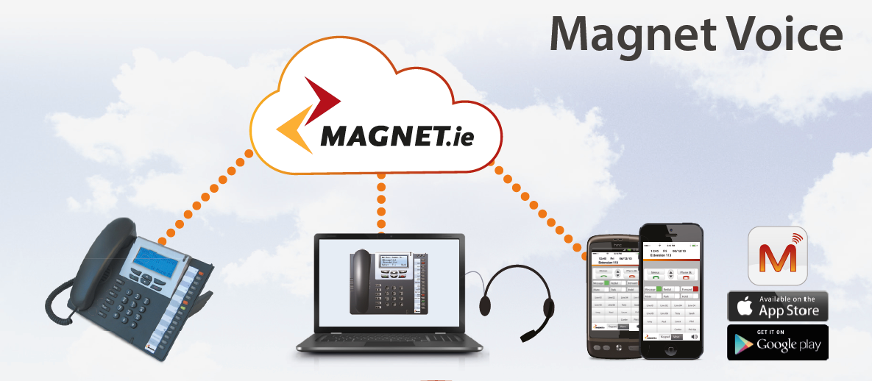
Free Calls to Staff and extra Premises

Slide 34
Irish SME’s using Cloud PBX set to double in 2015- why?
Business Continuity
your business is always contactable in a disaster recovery.
Ease of Management & Control
access and control your portal from anywhere in the world.
Mobility
with an iOS & Android Smartphone App, PC Phone
App and Executive Desktop phone take your number anywhere.
Scalability
scales with your business from a sole trader up to enterprise level.
Financial Savings & Value
one solution for all your staff, with competitive rates & enterprise features

Slide 35
Reasons for not Considering/Implementing Hosted Voice/VOIP
(Base: All who have not considered/implemented hosted Voice/VOIP – 216)
North (n=24) | West (n=27) | Mid-West (n=24) | South West (n=27) | South East (n=22) | Midland (n=31) | Mid-East (n=30) | Dublin (n=32)
44% | 48% | 50% | 58% | 47% | 56% | 68% | 35%
10% | 13% | 13% | 29% | 23% | 16% | 8% | -
10% | 14% | 12% | 7% | 9% | - | 12% | 16%
13% | 7% | 8% | 6% | 15% | 8% | 12% | 7%
17% | 3% | - | 13% | - | 4% | 8% | 4%
- | 7% | - | 3% | 4% | 4% | - | 16%
3% | 11% | 8% | 3% | 1% | 8% | 4% | 15%
Doesn't suit our company
Haven't got time to research
Prefer to keep functions in house
Available broadband insufficient
Concerned about security
Cost
Don’t know
Those in the North/Border region – 13% (Donegal, Sligo, Leitrim, Cavan, Louth, Monaghan) and the South-East – 15% (South Tipp., Waterford, Kilkenny, Carlow, Wexford) are most likely to say it is due to poor broadband connections.
Notes:
Over half (55%) of SMEs who have not implemented/considered Hosted Voice/VOIP feel that it does not suit their company. Larger SMEs (6+ employees) are more likely to give other reasons, indicative of a greater level of understanding.

Slide 36

Sending millions down the telephone line!
87% of SMEs say they have a standard telephone line
Average monthly bill for this service is €140 for SMEs there are over
180,000 SMEs in Ireland = €266million per annum
Movement to Hosted Voice/VOIP services could reduce this considerably.
Additional savings for the 76% of businesses using mobile phones.
Notes:
Over a quarter of a billion is spent annually by SMEs with 1-50 employees on telephone landlines when serious savings could be made by a move to Hosted Voice.

Slide 37
The South East… Takeaway Talking Points
SMEs in the South East are somewhat less confident about the future than those in other regions … similar to South West
However, they are likely to invest in IT in 2015 on par with most
They have better access to candidates with right skills when recruiting
They have little confidence in their public representatives
Awareness of Government supports the lowest in the country
Staff access to smartphones is low compared to elsewhere and the South East is one of the highest areas still using traditional phone line
Implementation of cloud services lags well behind Dublin
Notes:
Over a quarter of a billion is spent annually by SMEs with 1-50 employees on telephone landlines when serious savings could be made by a move to Hosted Voice.

Slide 38

Heard of an ‘Office in a Box’ solution?
Broadband
Phone System
Apps
Website
Hosting/Storage
E-Comms
E-Mail
Video
Training
….and more
€3000 but 50% back
or essentially 6 months free!

Slide 39

Will you be left traditional while others accelerate?
Talk to us about what version of an ‘Office in a Box’ will suit your business and we’ll help you apply
Attend another quick seminar in Wexford on simplifying the application process and apply with your LEO
We’ll take care of everything and get you setup in 4 weeks

Slide 40

Thank you
Notes:
As a B2B cloud telecoms provider, Magnet has a big part to play in helping our SMEs thrive and compete . We provide the underlying communication layer through an innovative suite of “Office in a Box” cloud services, web hosting and cloud phone services and Apps.
This research demonstrates the opportunity ahead for businesses across Ireland to enhance their competitive positioning by adopting cloud technology with the support of existing SME focused grant assistance.
For our part Magnet has identified the need to make this easy for small businesses. We are packaging a special solution tailored to SMEs which combines the two …. etc etc It coincides with the major player in the market raising prices …

